Slide 1
Mstock Account Registration

Slide 2
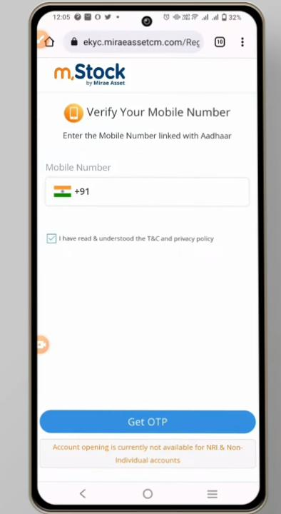
Step-1
Enter Mobile number which is Registered with Aadhar

Slide 3
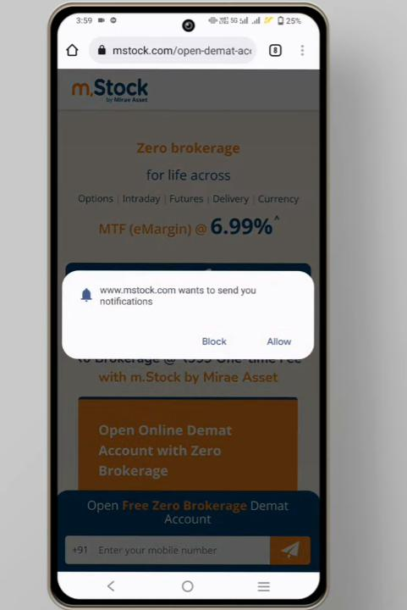
STEP-2
Allow Notifications to receive OTP’s

Slide 4
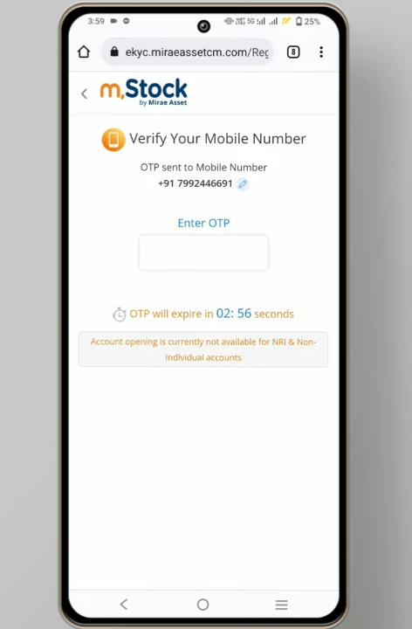
STEP-3

Slide 5
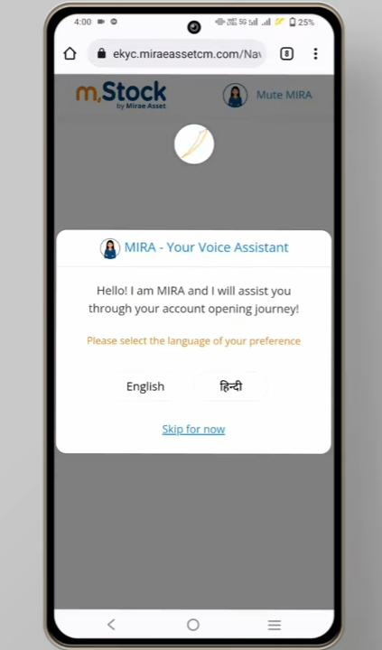
STEP-4
Click on the language for voice assistance

Slide 6
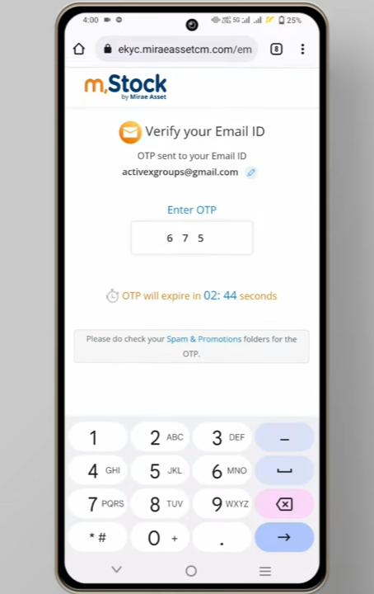
STEP-7

Slide 7
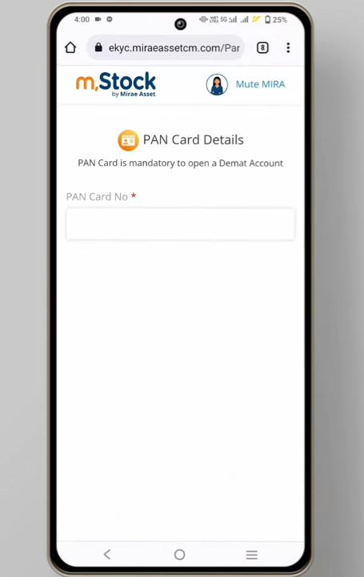
STEP-8
Enter PAN number which is linked with Aadhar

Slide 8
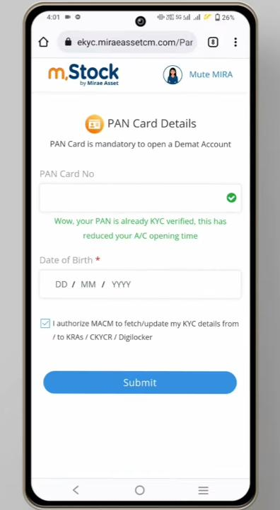
STEP-9
Enter PAN number and DOB and click on Submit

Slide 9
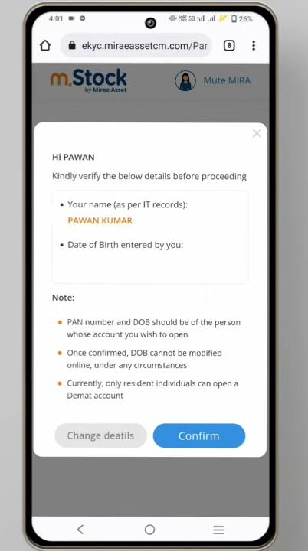
STEP-10
Check details and click on confirm

Slide 10
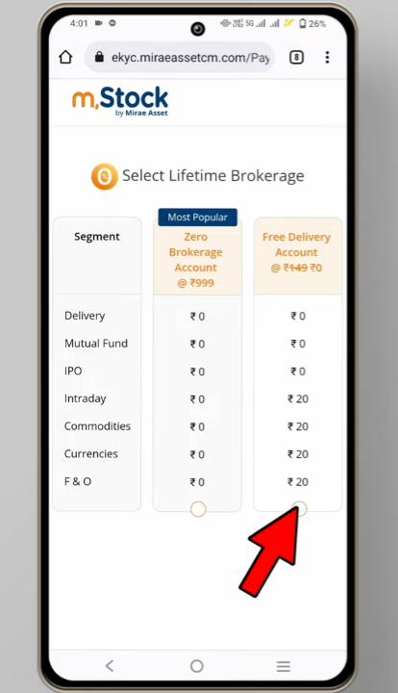
STEP-11
Select on the free plan as shown in the picture

Slide 11
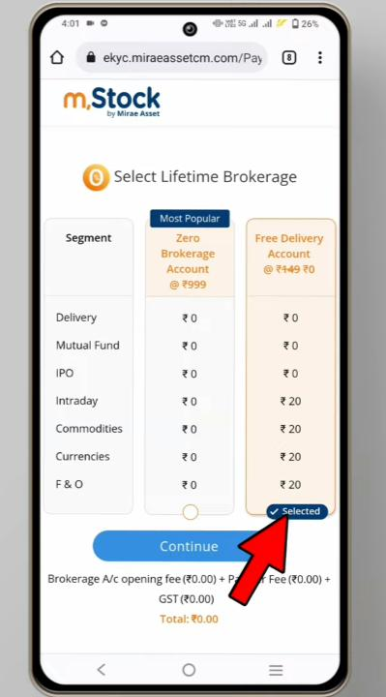
STEP-12
Click on continue after selecting

Slide 12
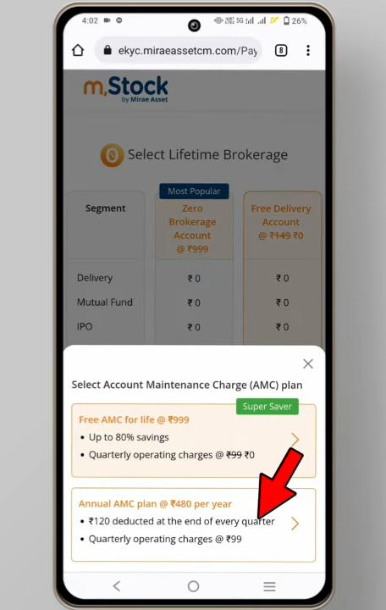
STEP-13
Click on the second option to continue with free Plan

Slide 13
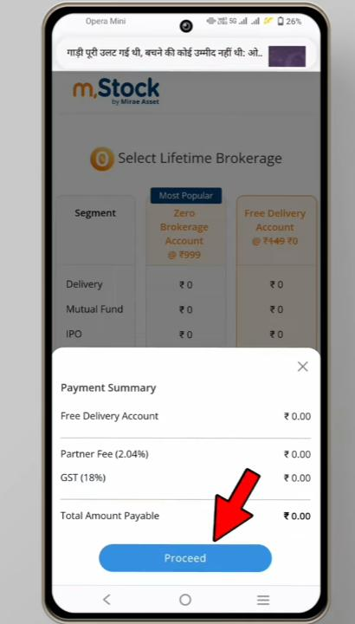
STEP-14
Click on Proceed to continue as shown in the highlighted area

Slide 14
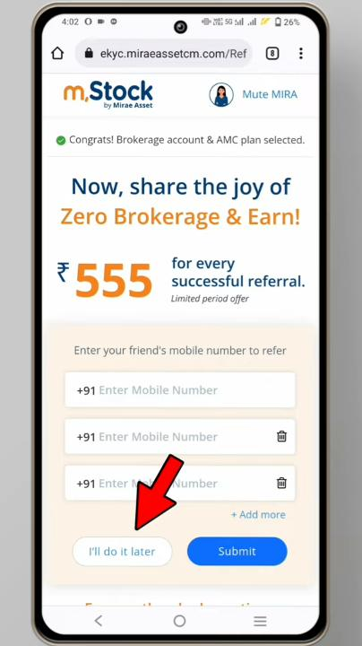
STEP-15
Here we are not supposed to pay for any brokerage plans so simply click on I will do it later

Slide 15
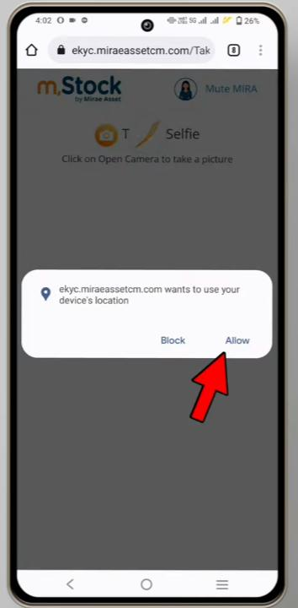
STEP-16
To begin with selfie options we need to allow the location access, so click on allow as shown in the highlighted picture

Slide 16
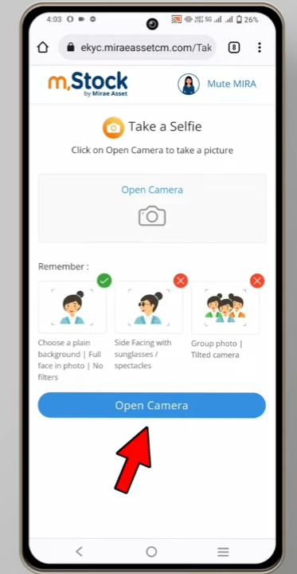
STEP-17

Slide 17
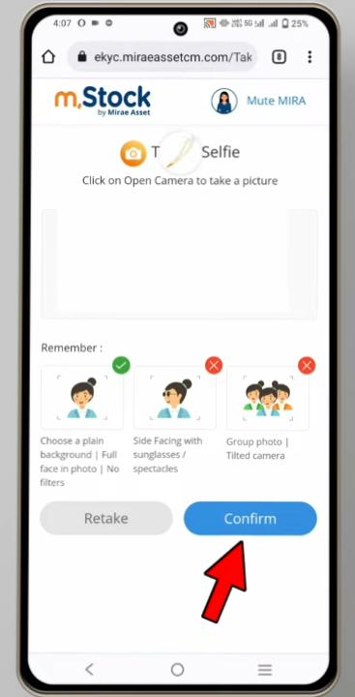
STEP-18
Click on confirm after taking a picture

Slide 18
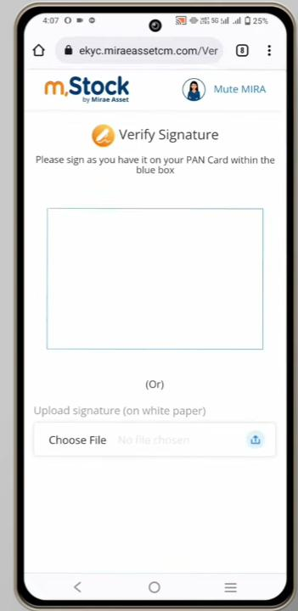
STEP-19
Here either we can do it a digital signature in the white box or we can upload a signature which is signed in a white paper by clicking on the choose file option

Slide 19
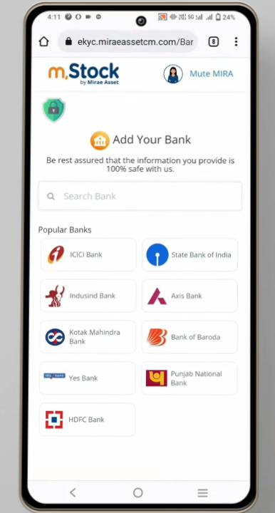
STEP-20
Select the bank which is Registered with your name or you can search it under search column

Slide 20
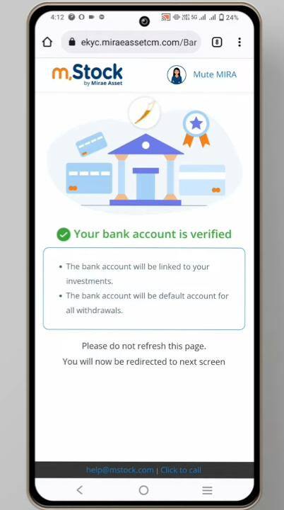
STEP-21
You will get a confirmation page like shown in the picture, do not refresh the page you will be directly continue to the next page with in few seconds

Slide 21
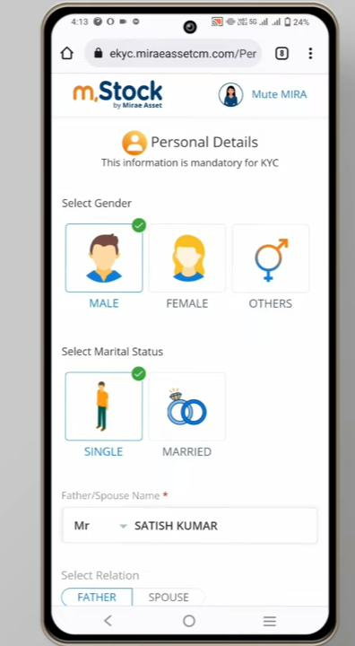
STEP-22
Select accordingly

Slide 22
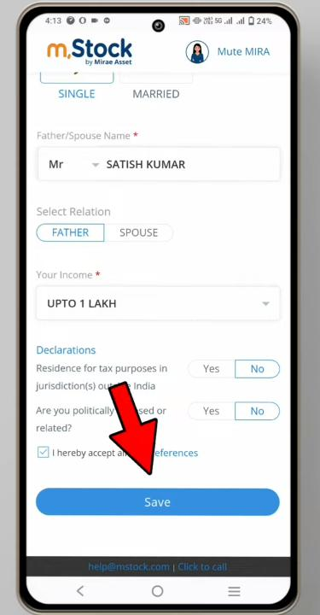
STEP-23
Select the options same as like picture and click on the save

Slide 23
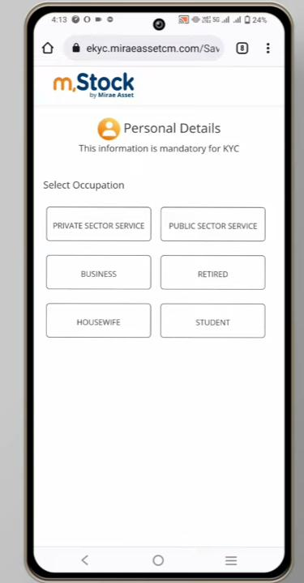
STEP-24
Select the segment as per your category

Slide 24
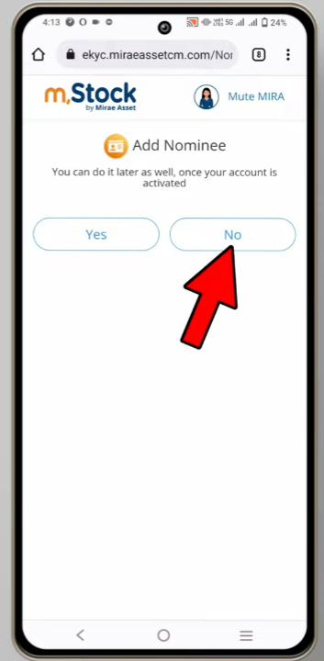
STEP-25
As of now we don’t required for Nominees so click on NO

Slide 25
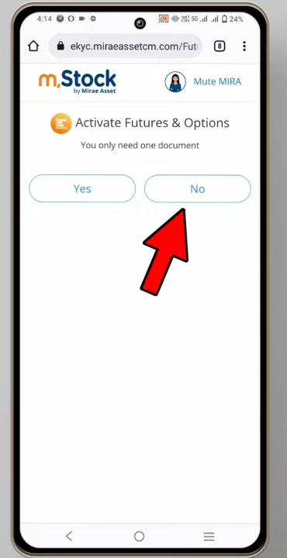
STEP-26
We also don’t required to select FNO option so click on NO

Slide 26
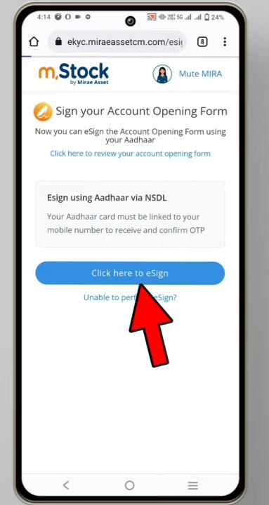
STEP-27
Click on the e sign to continue with NSDL page

Slide 27
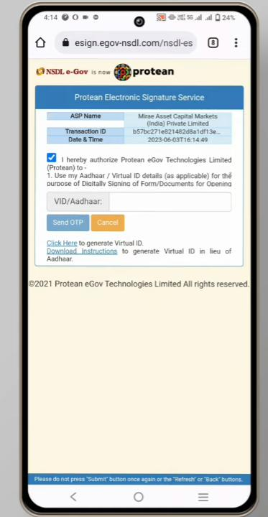
STEP-28
Here is the final confirmation tick on the check box and enter aadhar number and click on send otp

Slide 28
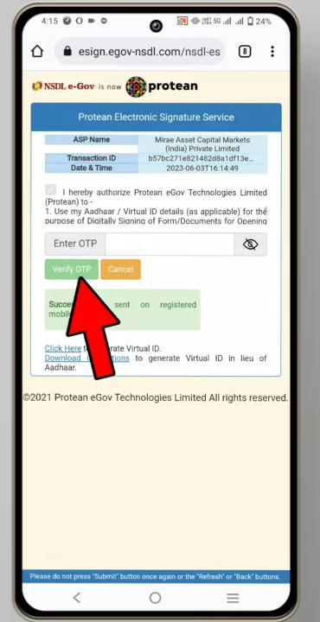
STeP-29
Enter OTP and on Verify

Slide 29
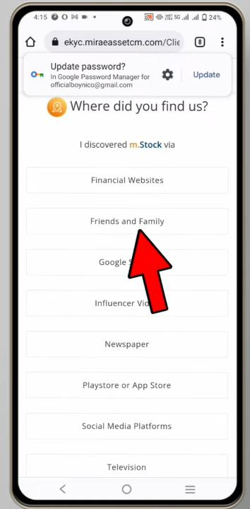
STEP-30
Can Select anyone of these options

Slide 30
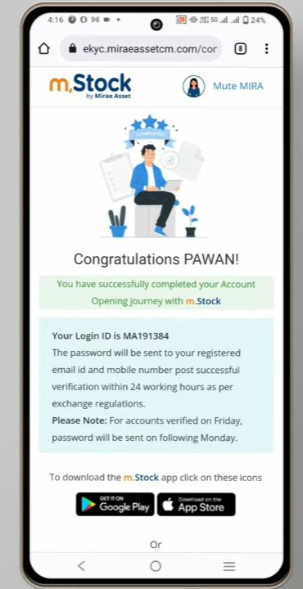
STEP-31
You will get a confirmation page like this and within 24 hrs you will get your login credentials to your Registered mail id

Slide 31
Thank you

